Slide 1

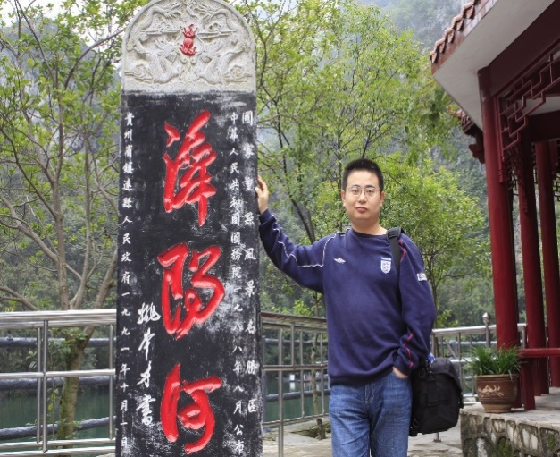
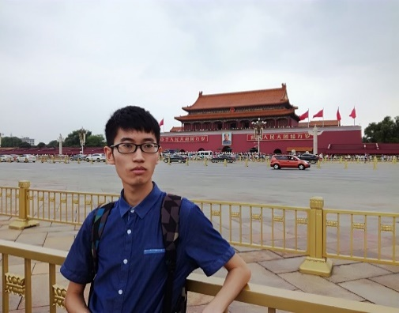
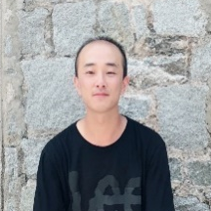





No Boundaries
ITU
AI/ML in 5G
Global Challenge
GuoLin
GangZhouwei
XiLin
Applying machine learning in
network extension optimization
RaoQianyin
FengZezhong
2019 CMCC Independent Development Competition Bronze Award
2020 CMCC Maker Marathon First Prize
Gold Sponsor
Bronze sponsors
Organized by

Slide 2
1
Problem
2
Result
3
Evolution
4
Outlook

Slide 3
Background——Problem Introduction
Transmission is the vessel of Telecommunication. To construct a highly efficient network, each node should be used efficiently to form the transmission network. While the actual situation is not the case.
Ex: Kaili PTN network consists of 3191 nodes, 913 rings
Low Load 483
High Load 82
Normal Load 348
Note: Kaili is one of the ten cities in Guizhou Province.
Notes:
传输是网络的血管，血管通过传输网各个节点连接而成，有效的利用各个节点才能组成高效的网络，但实际情况并不乐观。

Slide 4
Background——Optimization problem
As the network becomes more complex, topology optimization cannot be fully completed. Only local adjustment or node expansion can be used to solve the high-load ring problem and avoid affecting the business.
Possible Topologies=Nodes* Links
Ex: Kaili local network consists of 3191 nodes, 913 rings
Possible Transmission Network Number =3191*913=
Possible Topology | 9 Nodes | 19 Nodes | 29 Nodes | ……
3 Links | 27 | 57 | 87 | ……
6 Links | 54 | 114 | 174 | ……
9 Links | 81 | 171 | 261 | ……
…… | …… | …… | …… | ……
2,913,383！！！
Impossible to fully analyze and optimize the network topology
Notes:
传输是网络的血管，血管通过传输网各个节点连接而成，有效的利用各个节点才能组成高效的网络，但实际情况并不乐观。

Slide 5
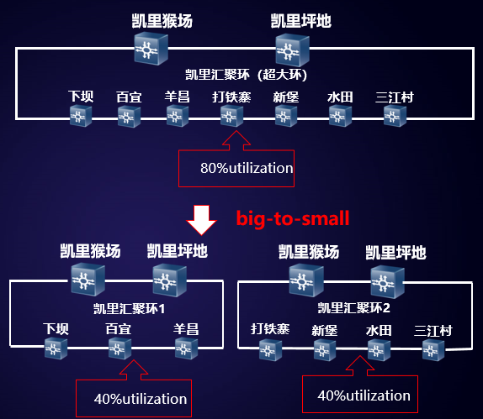
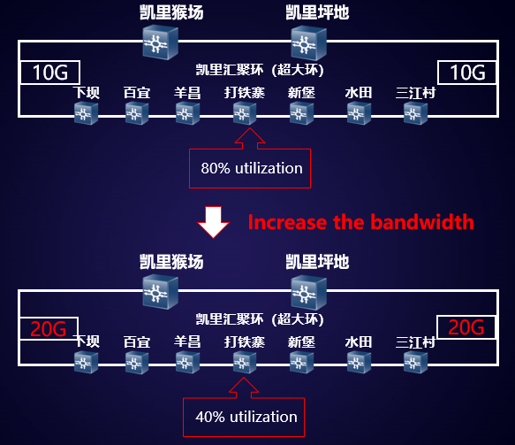
Background——Optimization problem
As the network becomes more complex, topology optimization cannot be fully completed. Only local adjustment or node expansion can be used to solve the high-load ring problem and avoid affecting the business.
Solution1:Local（Ring）Adjustment
Targeted "big-to-small" optimization for some links, reducing the number of nodes and load.
Solution2:Node Expansion
Increase the bandwidth of the link by upgrading hardware, and reduce link utilization.
Notes:
传输是网络的血管，血管通过传输网各个节点连接而成，有效的利用各个节点才能组成高效的网络，但实际情况并不乐观。

Slide 6
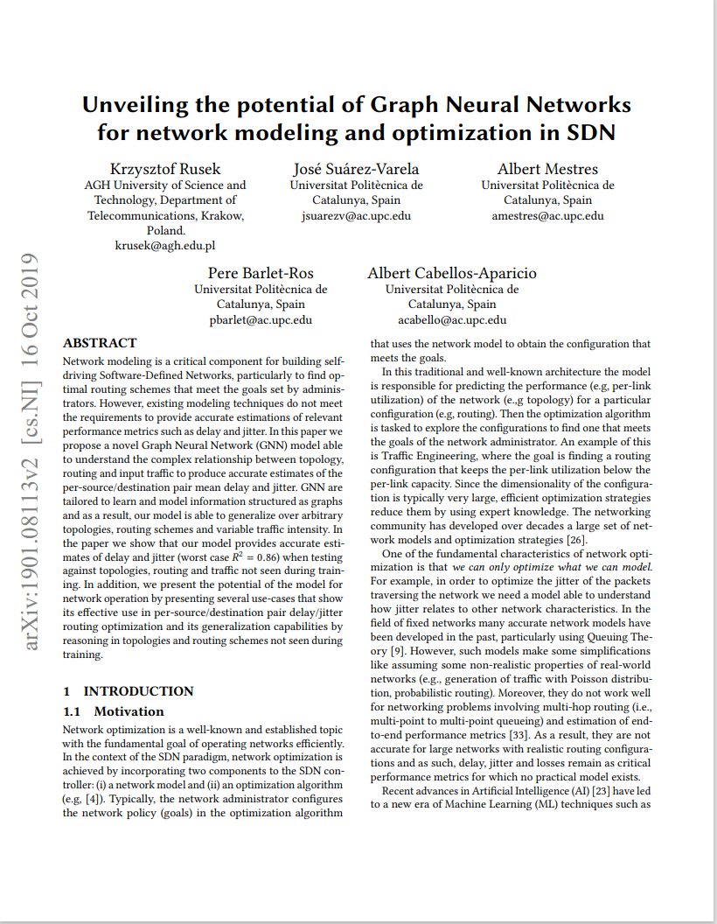
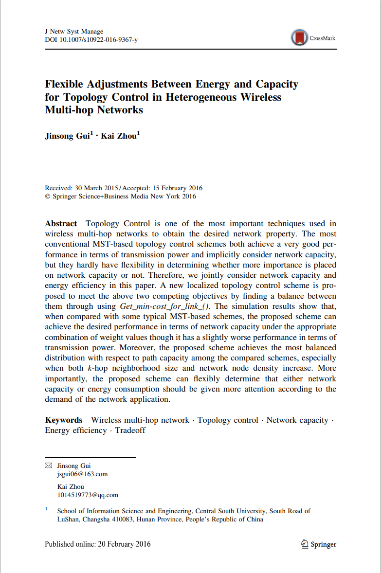
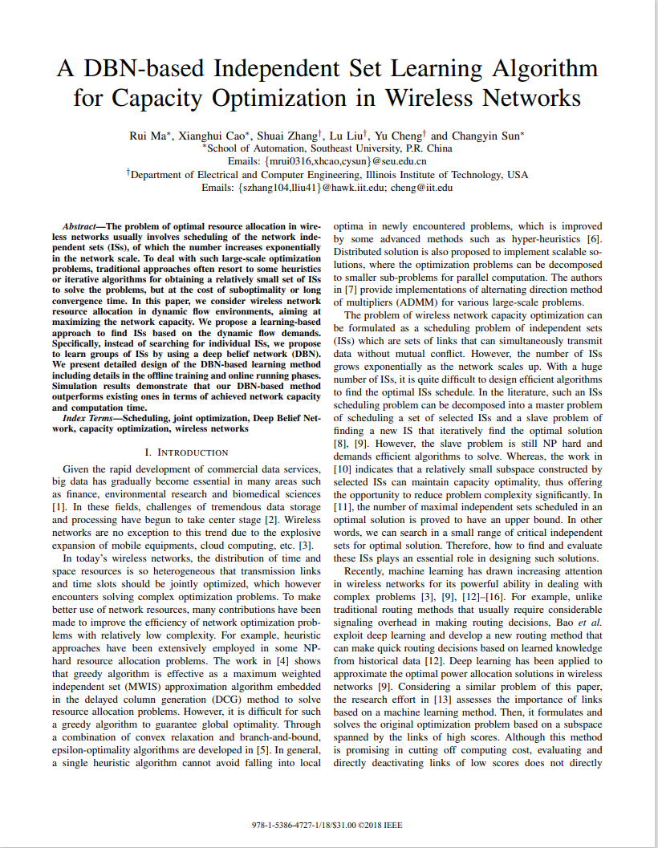
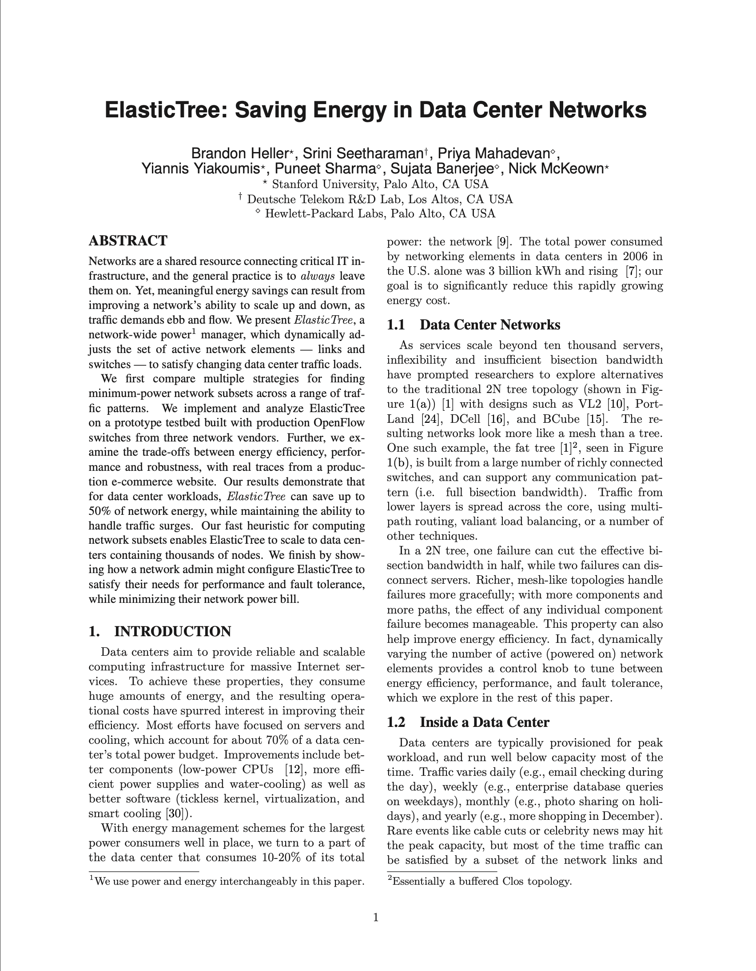
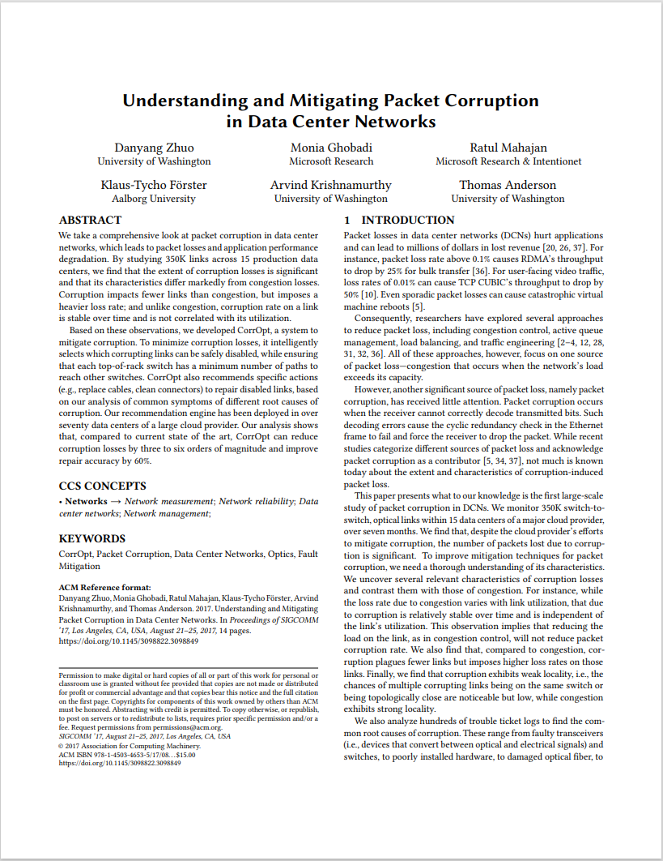
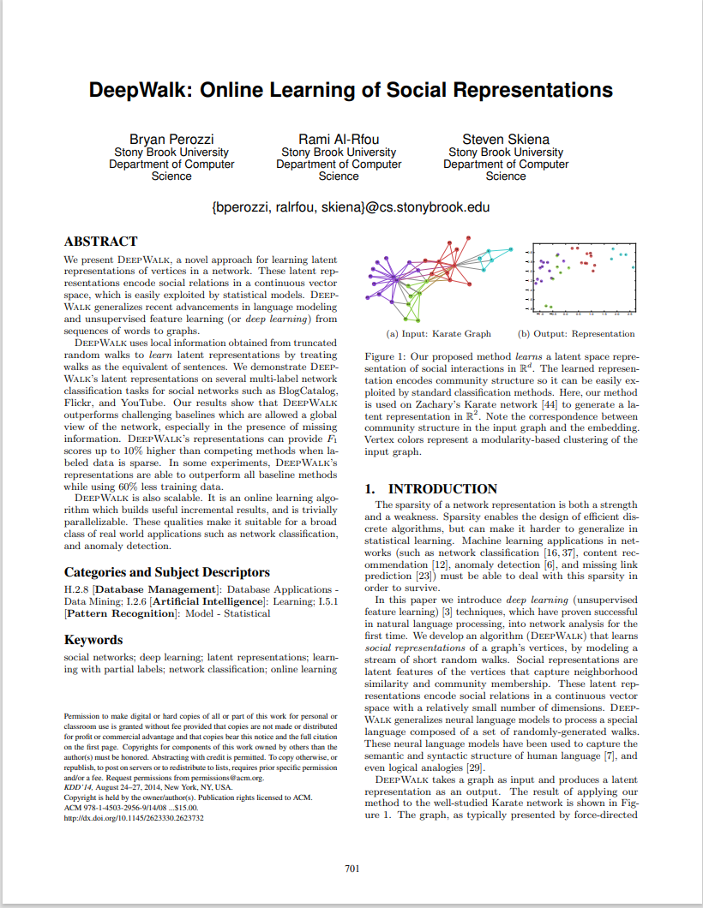
Background——Solution
Existing technologies and solutions cannot effectively solve the problem of network topology optimization. But it is enlightened that artificial intelligence can be used to complete topology optimization schemes.
SDN
1.《Unveiling the potential of Graph Neural Networks》
Wireless Network
1.《flexible adjustments between energy and capacity for topology control in hetreogeneous wireless multi-hop network》
2.《A DBN-Based Independent Set Learning Algorithm for Capacity Optimization in Wireless Networks》
Data Center Network
1.《ElasticTree_Saving_Energy_in_Data_Center_Networks》
2.《Understanding and Mitigating Packet Corruption in data center networks》
Internet
1.《DeepWalk: Online Learning of Social Representations》
Notes:
为解决上述问题，我们查询了很多参考文献，其中传输新技术的SDN更注重解决延迟，缺少拓扑优化指导。网络拓扑优化方案中，有无线网、数据中心和互联网场景，无线网的局限在于属于网络末端拓扑调整，与传输网全连接方式不一样。数据中心和互联网场景中节点数比起传输网不是一个量级，无法使用。但是我们从这些文献中得到启示，可以尝试运用人工智能将拓扑优化方案交由机器完成，通过智能化运维提升网络资源利用率。

Slide 7
1
Problem
2
Result
3
Evolution
4
Outlook

Slide 8
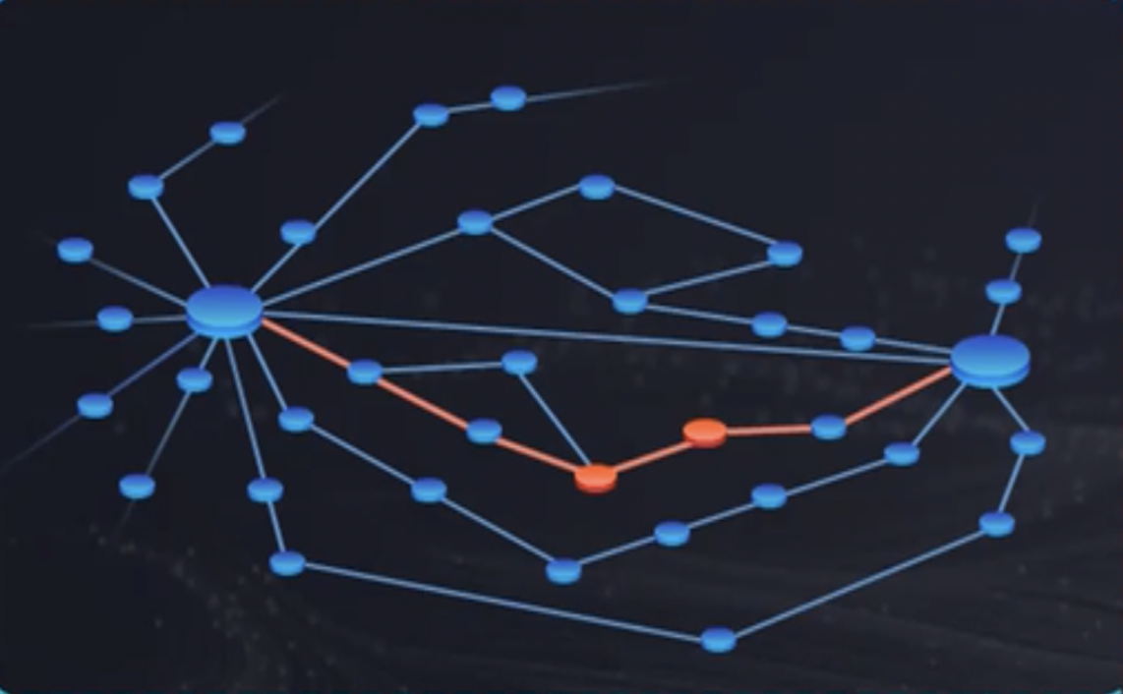
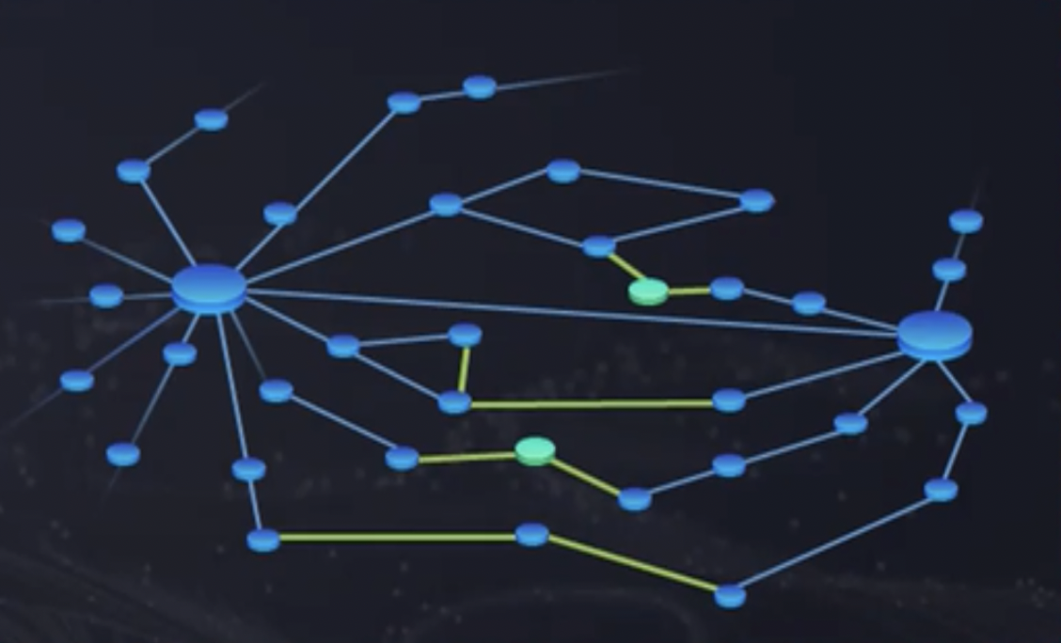
Ideas——Problem Analysis
The problem is based on real data on the live network, allowing developers to simulate and automatically optimize the network topology.
Now
Future
optimize
2000 Nodes
Previous Traffic
Topology
Latitude and Longitude
Choose Recommendation ITU-T Y.3172
ML Pipeline Subsystem
ML Management Subsystem
ML Sandbox Subsystem
Adopt
Notes:
为了符合生产，赛题以2000个节点为基础，提供这些节点20天流量、经纬度、连接关系。并给出优化规则和评估算法，要求开发者在沙盒中模拟网络拓扑并提出优化方案。
通过赛题分析，选择ITU建议Y.3172“未来网络中的机器学习架构框架”较为符合本次赛题需要。在未来网络中的机器学习架构框架中主要包含三个组件,ML sandbox system ,ML pipeline subsystem and Management subsystem。我们主要选择并依据ML pipeline subsystem 组件进行实现。

Slide 9
Ideas——Problem Analysis
The problem is based on real data on the live network, allowing developers to simulate and automatically optimize the network topology.
Now
Future
optimize
2000 Nodes
Previous Traffic
Topology
Latitude and Longitude
Choose Recommendation ITU-T Y.3172
ML Pipeline Subsystem
ML Management Subsystem
ML Sandbox Subsystem
Adopt
Notes:
为了符合生产，赛题以2000个节点为基础，提供这些节点20天流量、经纬度、连接关系。并给出优化规则和评估算法，要求开发者在沙盒中模拟网络拓扑并提出优化方案。
通过赛题分析，选择ITU建议Y.3172“未来网络中的机器学习架构框架”较为符合本次赛题需要。在未来网络中的机器学习架构框架中主要包含三个组件,ML sandbox system ,ML pipeline subsystem and Management subsystem。我们主要选择并依据ML pipeline subsystem 组件进行实现。

Slide 10
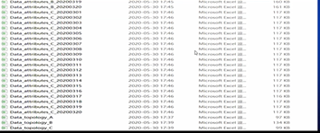
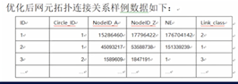
Development——Architecture Design
The design result mainly includes three parts: preprocessing, model and strategy.
ML pipeline
ML underlay networks
Data handling reference point
SRC
C
PP
M
P
D
SINK
RAW Data
1 Topology+20 Node Attributes
Data Pre-Processing
Topology Restore
Topology optimization strategy
input
output
Design
30
Result Data
Traffic Forecast
Data cleaning for subsequent operations
balanced the load by optimizing the topology
Topology Restore
Forecast node traffic based on changes
Notes:
SRC（源）：此节点是可用作ML管道输入的数据源。
注2 –潜在的SRC节点包括用户设备（UE），会话管理功能（SMF）[b-ITU-T Y.3104]和应用功能（AF）[b-ITU-T Y.3104]。
C（收集器）：此节点负责从一个或多个SRC节点收集数据。
注3 –收集器节点可能具有配置SRC节点的能力。例如，无线电资源控制（RRC）协议[b-3GPP TS 23.501]可用于配置充当SRC节点的用户设备（UE）。收集器节点可以使用供应商特定的操作，管理和维护（OAM）协议来配置充当SRC节点的SMF。这样的配置可用于控制数据的性质，从SRC生成的数据的粒度和周期性。
•PP（预处理器）：此节点负责清理数据，聚合数据或执行将数据以适当格式显示所需的任何其他预处理，以便ML模型可以使用它。
•M（模型）：这是一种机器学习模型，其形式可在机器学习管道中使用。
注4 –示例是在软件中作为NF实现的ML算法[b-ITU-T Y.3104]。
•P（策略）：此节点允许将策略应用到模型节点的输出。
注5 –例如，当机器学习的输出应用于实时ML底层网络时，可以使用此节点来最大程度地减少影响。网络运营商可以制定特定规则来维护网络的健全性，例如，大型升级只能在夜间或网络中的数据流量较低时进行。
•D（分发者）：此节点负责标识SINK，并将M节点的输出分发到相应的SINK节点。
注6 –它可能具有配置SINK节点的能力。例如，RRC协议可以用于配置充当SINK节点的UE。
•SINK：此节点是对其执行操作的ML输出的目标。
注7 –例如，充当SINK节点的UE可以基于ML输出来调整信道测量的周期性。
注8 –节点的“服务出口点”是可以访问该节点公开的服务（生产者角色）的点。节点的“服务入口点”是可以消费其他节点的服务（消费者角色）的点。

Slide 11
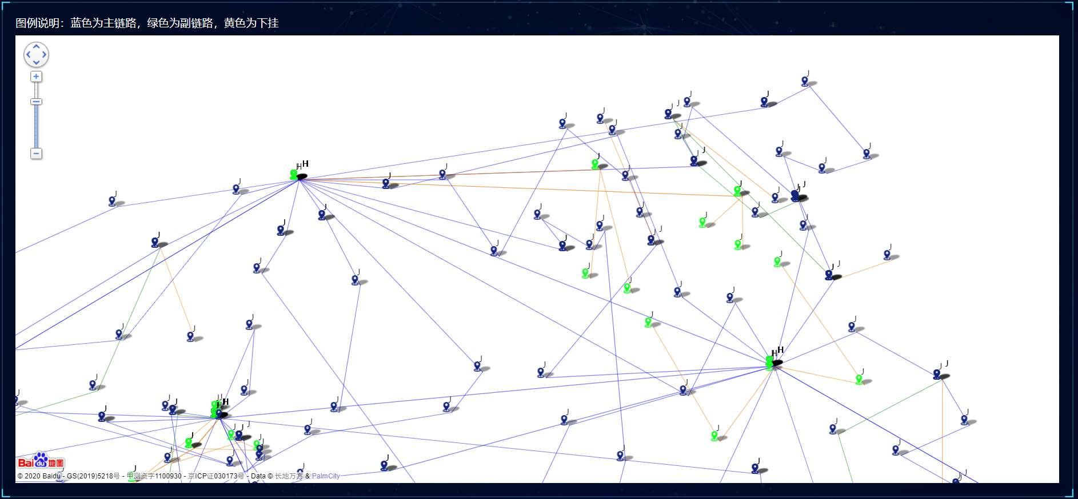
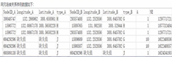
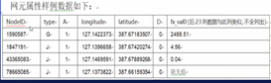
Development——Achievement Exhibition
Preprocessing, model and strategy, with unique advantages.
Provided Data
Python+pandas+Tensorflow
Topology diagram by Qunee
Network Topology
Topology Restore
Topology optimization strategy
Data pre-processing
RAW Data
1 Topology
+
20 Node Attributes
Design
Node Attributes
Location and Traffic
Traffic Forecast
1、Adopt adjacency matrix to query node connection relationship for higher efficiency
2、Use BFS to search topology for faster searching speed
Innovation：
The BFS search node can be accessed repeatedly to adapt the search of the link set
1、Adopt adjacency matrix to store node connection relations
2、Use pandas to fill in missing traffic data
3、 Mark nodes with missing latitude and longitude
Modeling with LSTM
Innovation：
1、Model each node and make predictions separately
2、 Each neuron carries 24 traffic data
1、optimize overloaded links
2、optimize low-load links
3、 aggregate low-load links
Innovation：
Aggregate low-load links with the same head and tail nodes
Notes:
程序中3个功能模块，其中拓扑还原和拓扑优化本质是一类问题，是在原有数据集合中，根据新的条件，整理形成新的数据集合，应该使用搜索算法。而流量预测的本质是基于事物过去变化，挖掘规律，实现未来时间预测，因此应该使用时间序列预测算法。

Slide 12
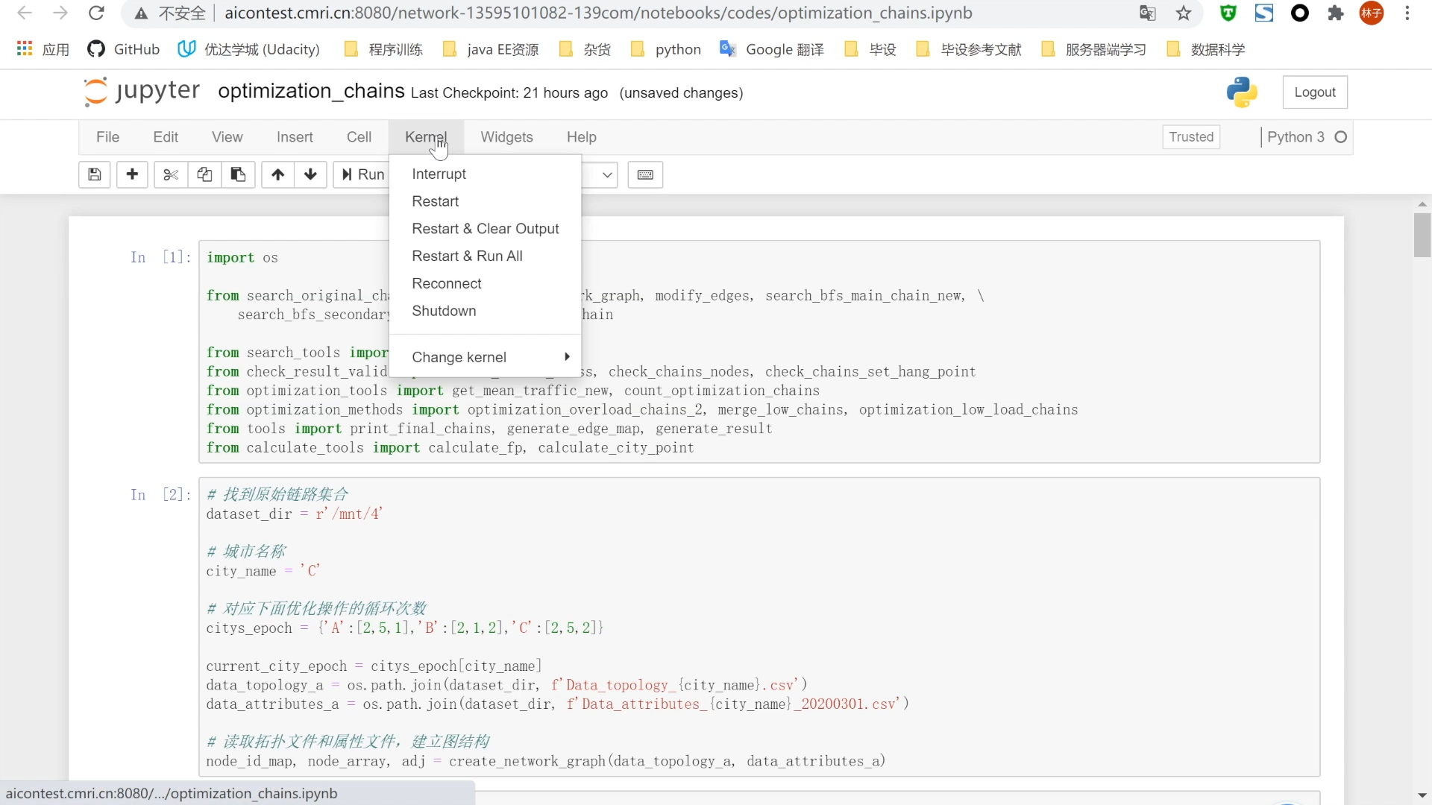
Results——Video Demo
A video demo for our project.
Notes:
左图是根据拓扑还原C市原始拓扑，右图是优化后拓扑，其中绿色点就是被优化的节点。请点击一下动画，由于图比较密，我们选择一个地方放大显示。我们的拓扑优化思路是先搜索出低负载链路进行融合处理，再搜索出高负载链路进行拆分处理，最后再进行一次低负载链路优化，获得优化拓扑结果。

Slide 13
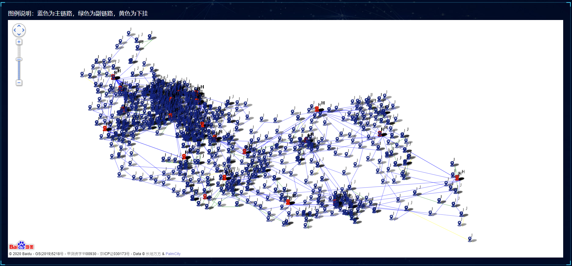
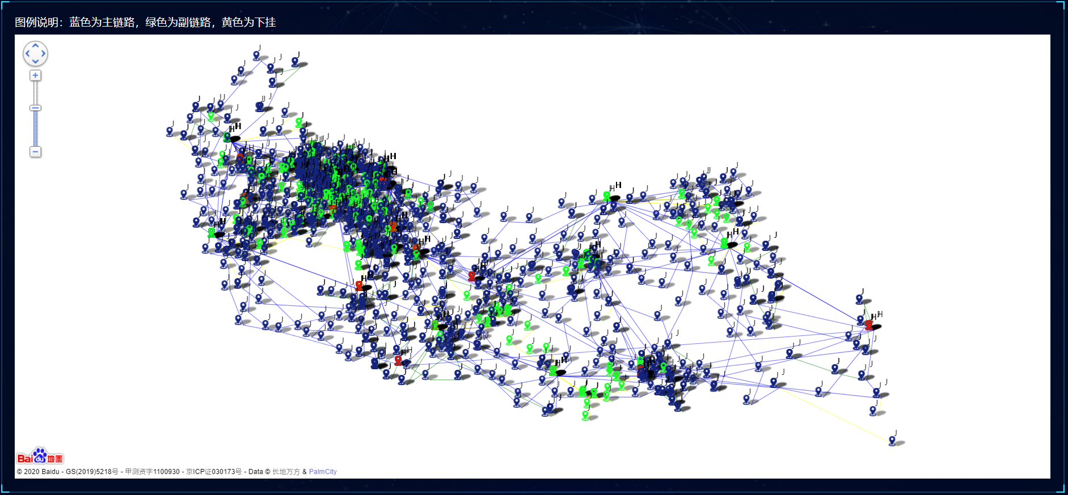
Results——Achievement Exhibition
The Algorithm automatically completed the topology optimization plan of City C in 10 minutes and obtained 44.55 points
Original Topology
Optimized Topology
Green for optimized nodes
Notes:
左图是根据拓扑还原C市原始拓扑，右图是优化后拓扑，其中绿色点就是被优化的节点。请点击一下动画，由于图比较密，我们选择一个地方放大显示。我们的拓扑优化思路是先搜索出低负载链路进行融合处理，再搜索出高负载链路进行拆分处理，最后再进行一次低负载链路优化，获得优化拓扑结果。

Slide 14
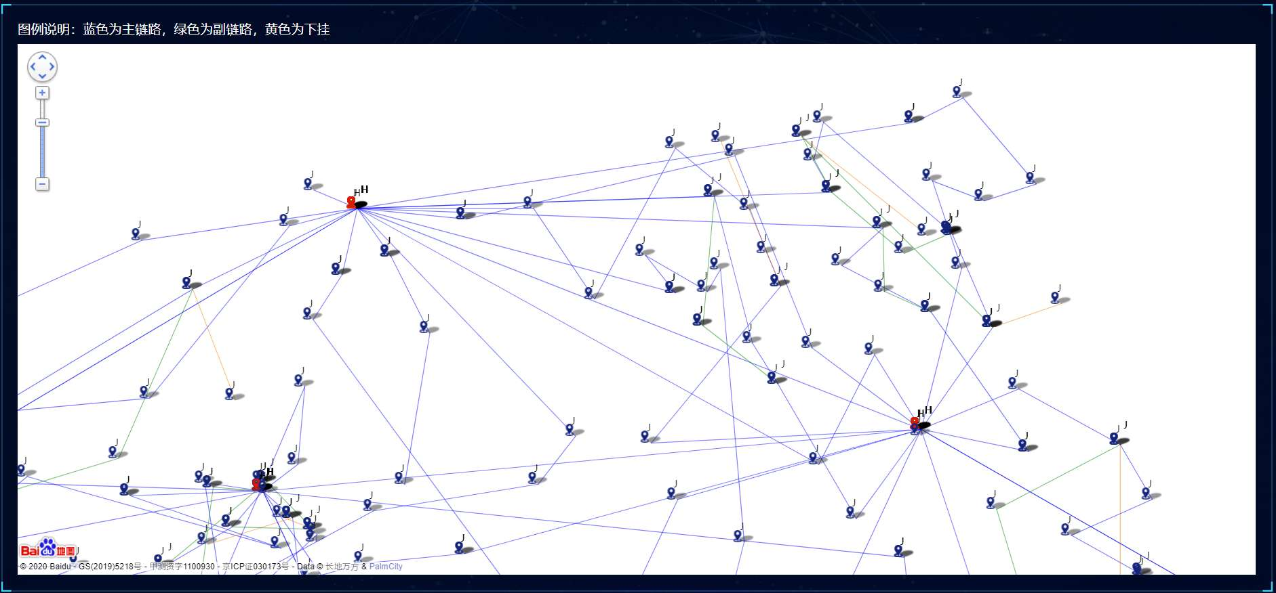
Results——Achievement Exhibition
The Algorithm automatically completed the topology optimization plan of City C in 10 minutes and obtained 44.55 points
Original Topology（ Zoomed view）
Optimized Topology（ Zoomed view）
Green for optimized nodes
Notes:
左图是根据拓扑还原C市原始拓扑，右图是优化后拓扑，其中绿色点就是被优化的节点。请点击一下动画，由于图比较密，我们选择一个地方放大显示。我们的拓扑优化思路是先搜索出低负载链路进行融合处理，再搜索出高负载链路进行拆分处理，最后再进行一次低负载链路优化，获得优化拓扑结果。

Slide 15
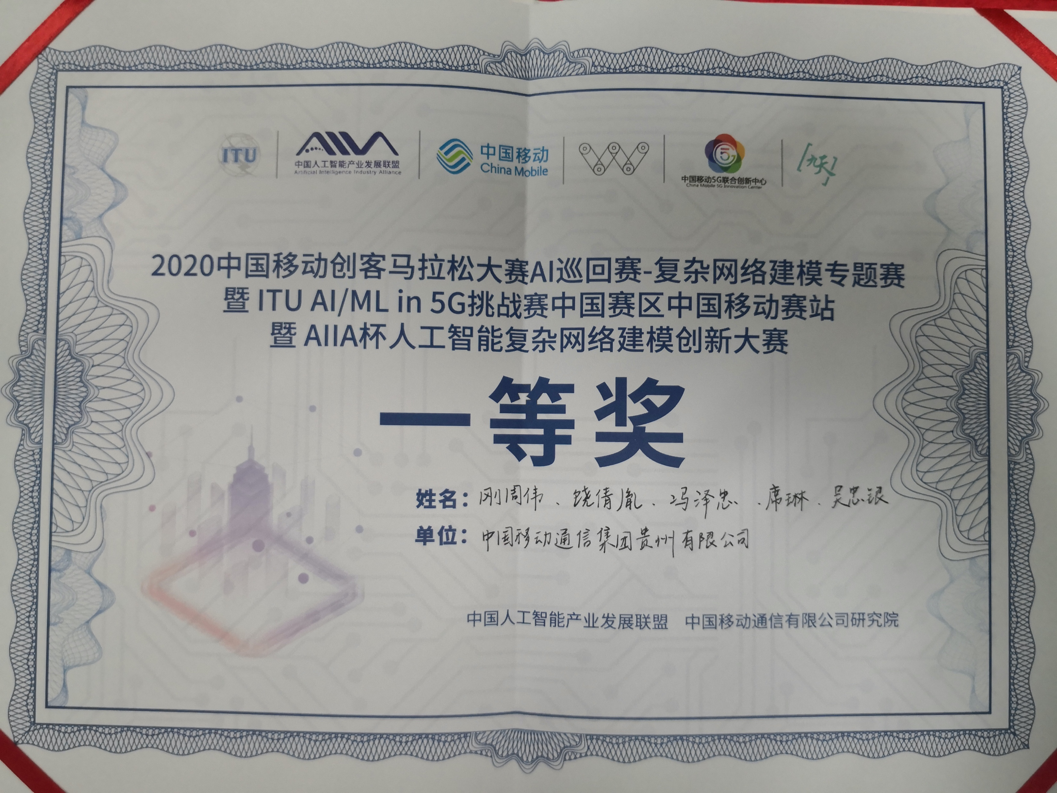
Results——Feedback
In the finals, the host highly affirmed the results and awarded us the first prize.
Advantage
Result
Verify the effect through pilot projects and confirm the actual effect of the results
1. Many special situations are considered in the traffic forecast, and the thinking is comprehensive。
2. Advantages in topology restoration, and a unique topology optimization strategy has been established.
3. For data preprocessing, adjacency matrix is applied to store the connection relationship for faster query speed. The idea of using the average value to complete the missing data solves the inconsistency between the actual and ideal.
4. Good model generalization, robustness and practicability.
5. Propose an innovative approach suitable for link set search.
First prize in the final
Advice
1. Improve traffic forecast
2. Improve optimization strategy with Genetic algorithm
3. Docker Support for Peripheral features

Slide 16
1
Problem
2
Result
3
Evolution
4
Outlook

Slide 17
Improvement——Traffic Forecast
Feedback “try to add peripheral features to the traffic forecast and use multi-modal data modeling”
Topology Restore
Topology optimization strategy
Network Topology
Data pre-processing
RAW Data
1 Topology
+
20 Node Attributes
Node Attributes
Location and Traffic
Traffic Forecast
Solution
Result
Three features are added when modeling, considering the influence of surrounding nodes:
1、Add features: add weather, weekends, so that it has characteristics of traffic, weather, and weekends;
2、Add surrounding nodes: It is assumed that nodes within a certain range (500 meters) have an impact on the node traffic of the current link.
Average forecast accuracy increased by 3.6%
Notes:
我们团队最终得分为44.55分，排名第二。

Slide 18
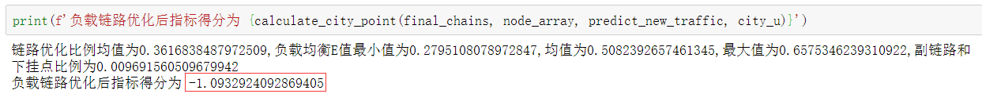
Improvement——Optimization Strategy
Feedback“The topology optimization strategy can be improved, and it is recommended to consider the use of genetic algorithm for improvement.”
Topology Restore
Topology optimization strategy
Network Topology
Data pre-processing
RAW Data
1 Topology
+
20 Node Attributes
Node Attributes
Location and Traffic
Traffic Forecast
Solution
Result
The greedy algorithm is used to optimize the topology, and the node is moved based on the highest evaluation index score.
The link optimization ratio increased from 0.36 to 0.4
Notes:
我们团队最终得分为44.55分，排名第二。

Slide 19
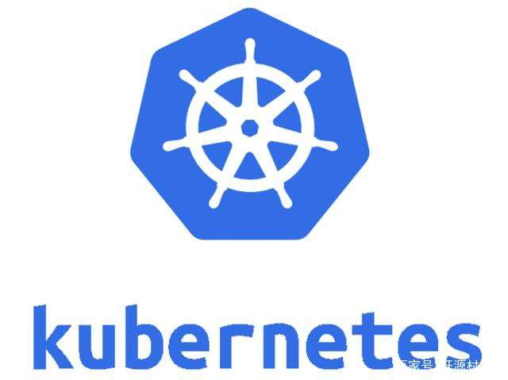
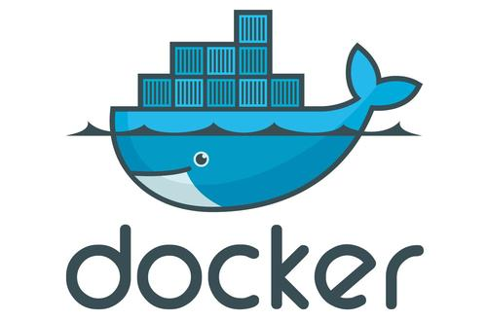
Improvement——Model encapsulation
Feedback“using Docker for packaging, and referring to ITU specifications to try to provide services in the form of a capability open platform”
Topology Restore
Topology optimization strategy
Network Topology
Data pre-processing
RAW Data
1 Topology
+
20 Node Attributes
Node Attributes
Location and Traffic
Traffic Forecast
Solution
Result
Capability scheduling、Self-healing、Horizontal Expansion and Data Sharing
1. Instantiation time of N nodes = single node time
2. MLFO shortens development time by 70%
3. Data sharing reduces storage consumption by 50%
4. Service self-healing reduces failure to affect business by 80%
Web Interface、Virtualization、CI/CD

Slide 20
Improvement——Model encapsulation
Feedback“using Docker for packaging, and referring to ITU specifications to try to provide services in the form of a capability open platform”
CI/CD:k8s , gitlab , docker regrstry
M
L
FO
Topology Restore
Topology optimization strategy
Capability Encapsulation
Topology Restore Capability
Traffic Forecast Capability
Traffic Forecast
Topology Optimization Capability
Solution
Result
Capability scheduling、Self-healing、Horizontal Expansion and Data Sharing
1. Instantiation time of N nodes = single node time
2. MLFO shortens development time by 70%
3. Data sharing reduces storage consumption by 50%
4. Service self-healing reduces failure to affect business by 80%
Web Interface、Virtualization、CI/CD

Slide 21
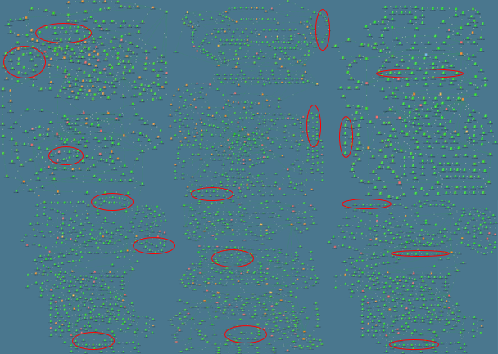
Improvement——Verify in Production
We chose Kaili City for the pilot city. We Solve 16 high-load ring with the help of this technology.
Kaili PTN Network：3191 Nodes，913 Rings
Before（%）
After（%）
Plan | Traditional Plan | AI Plan
Construction Cost | ￥3.05M | ￥0.45M
Human Input | 21 Man-Day | 4 Man-Day
Low-load rings | 40 | 3
Threshold crossing rings | 5 | 0
Capacity (day) | 102T | 181T
Notes:
选择中国移动贵州凯里市进行试点，为确保网络稳定，每次调整后进入3天的观察周期，经过20次调整，在没有新增节点和扩容的基础上，带宽利用率越限环链从16个优化为0，整体网络峰值带宽利用率均低于70%。本次网络拓扑优化较传统方案节省建设成本260万，人员投入17人天，提升网络吸收流量79TB/天。

Slide 22
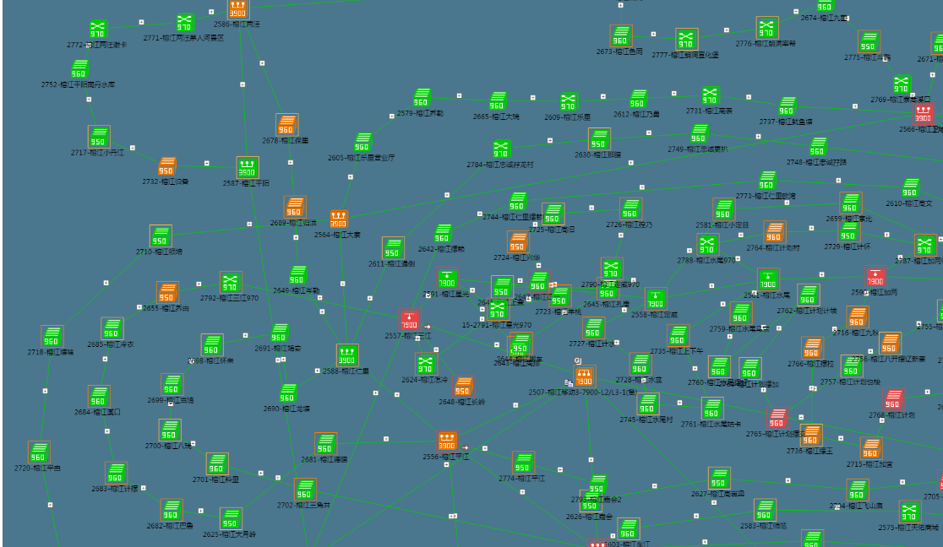
Improvement——Verify in Production
We chose Kaili City for the pilot city. We Solve 16 high-load ring with the help of this technology.
Ring 1 and Ring 10：
Ring 1 and Ring 10 optimization:
Note：00:00-01:00 is time for optimization
Notes:
选择中国移动贵州凯里市进行试点，为确保网络稳定，每次调整后进入3天的观察周期，经过20次调整，在没有新增节点和扩容的基础上，带宽利用率越限环链从16个优化为0，整体网络峰值带宽利用率均低于70%。本次网络拓扑优化较传统方案节省建设成本260万，人员投入17人天，提升网络吸收流量79TB/天。

Slide 23
1
Problem
2
Result
3
Evolution
4
Outlook

Slide 24
Outlook——Evaluation
Recommendation ITU-T Y.3173
Future network intelligence level assessment framework including IMT-2020
Basis of Evaluation ：Y.3173 P12，Table 7-1
Network intelligence level | Dimensions
 | Action implementation | Data collection | Analysis | Decision | Demand mapping
L0 | Human | Human | Human | Human | Human
L1 | H&S | H&S | Human | Human | Human
L2 | System | H&S | H&S | Human | Human
L3 | System | System | H&S | H&S | Human
L4 | System | System | System | System | H&S
L5 | System | System | System | System | System
Demand mapping ：
Demand mappings are done by human, so the rating is Human.
Decision ：
The topology optimization scheme given by the system needs people to evaluate and verify, and then decide whether to implement it, so the rating is H&S.
Analysis ：
Data analysis requires people to choose specific analysis algorithms and analysis rules, and cannot be automatically selected and constructed by the system, so the rating is H&S.
Data collection ：
Data collection requires people to define fields and collection rules, and then the system automatically collects them, so the rating is H&S.
Action implementation :
Transmission topology optimization involves optical cable splicing. In the case of link disconnection, it can be realized through system use cases. In the case of link establishment, it is a manual operation, so it is rated as H&S.
Dimensions |  |  |  |  | Overall network intelligence level
Action implementation | Data collection | Analysis | Decision | Demand mapping
Human | Human&System | Human&System | Human&System | Human&System
L1 | L2 | L3 | L3 | L3 | L1
Notes:
从扩展性上说，可以扩展输入，提升预测准确性和优化效果，也可以扩展输出，用于更多设备预测或更多预测场景。从技术上说，软件方面开源且便于部署。而且成果用于更多城市。从应用上说，可以广泛用于现网网络规划工作，从而支撑即将来临的5G大发展。

Slide 25
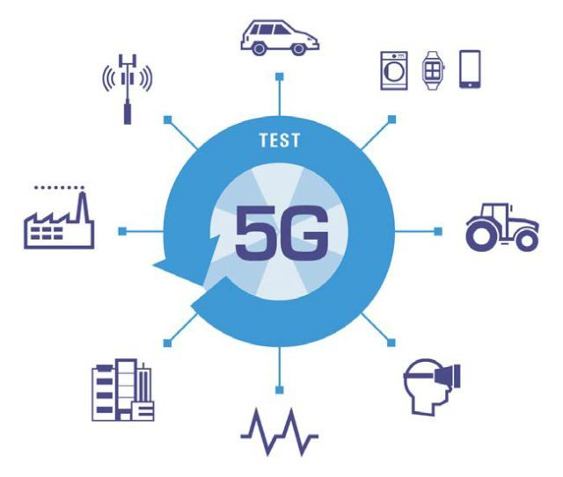




Outlook——5G、 Ecosphere 、AItoB
5G
The combination of communication maintenance and AI can accelerate the promotion of complex 5G network.
Only for
For
everything
Ecosphere
In CMCC, an ecosystem of people + platform + standards has been formed.
New Tech
ISP screening
Platform Update
Platform defect
Developer
Platform
Standards
AItoB
AItoC：
To meet people’s needs and meet people’s living and working habits.
AItoB：
To meet enterprises' needs with corporate standards and processes.
This study will provide an example for the AItoB model.
Notes:
4G时代之前都是人与人的连接，5G时代之后增加了人与物，物与物的连接，最终走向万物互联。网络复杂程度将指数级增长，本次通信运维和AI结合的可能性，可以大幅减轻复杂网络的运维成本，从而加快推动万物互联时代的到来。
ITU框架和标准为智能运维打下基础，在中国移动，借助九天智慧中台和广泛开发者，已经形成人+平台+标准的生态圈，孵化出百花齐放的智能运维种子，运营商通过筛选后推动种子成长为大树，形成一个闭环的生态圈。
传统通信在ITU的远期规划下，与IT新技术融合是对AI模式的一种探索，不同于传统AI直接服务于单个客户toC模式，这种新型AI通过服务网络为更多用户是一种toB模式，是蓝海。

Slide 26


END
Thanks
Notes:
谢谢各位聆听。

